Slide 1



Programming HeuristicLab
Basics
A. Scheibenpflug
Heuristic and Evolutionary Algorithms Laboratory (HEAL)
School of Informatics/Communications/Media, Campus Hagenberg
University of Applied Sciences Upper Austria

Slide 2
Prerequisites
You should
know how to use HeuristicLab
have a basic understanding of what metaheuristics are
know how to write code
know C# or Java or similar languages
This is not a user guide
This is an overview
For details have a look at the source code

Slide 3
Introduction
HeuristicLab (HL) is quite a big project
As of 3.3.12:
5 VS solutions containing 173 projects
Lines of code: 670.526 + 890.638 (EXT) = 1.561.164 LOC
368 unit tests
Quite a lot of feature branches in the SVN repository
There are certain patterns/concepts that are used throughout all that code

Slide 4
Extension Points
HL can be extended in multiple ways
User-defined algorithm
User-defined problem
Programmable operators
Programmable problem
C# Script
Plugins

Slide 5
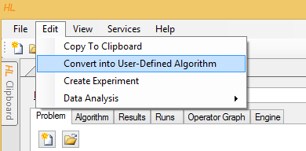
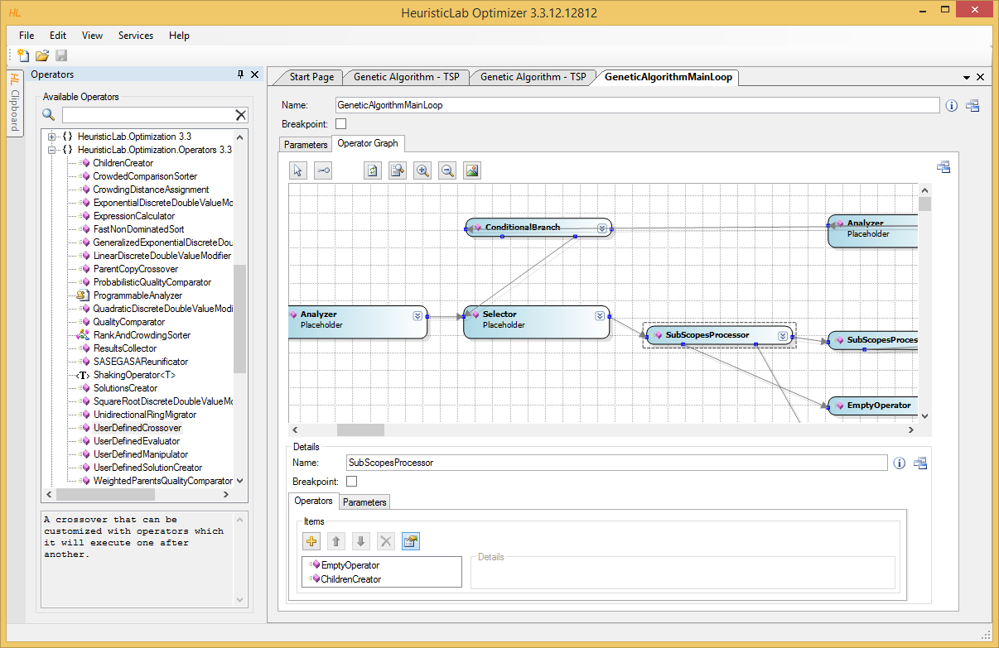
User-defined algorithm
Start from an existing algorithm
No programming skills required
Useful for smaller modifications and prototyping
Caution: Wiring is not active

Slide 6
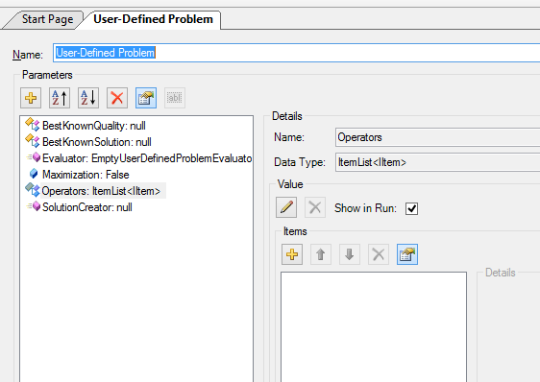
User-defined problem
Define a problem in the UI
Use user-defined operators to fill the problems operator collection
Usage of programmable operators also possible (e.g. programmable analyzer)
No programming skills required

Slide 7
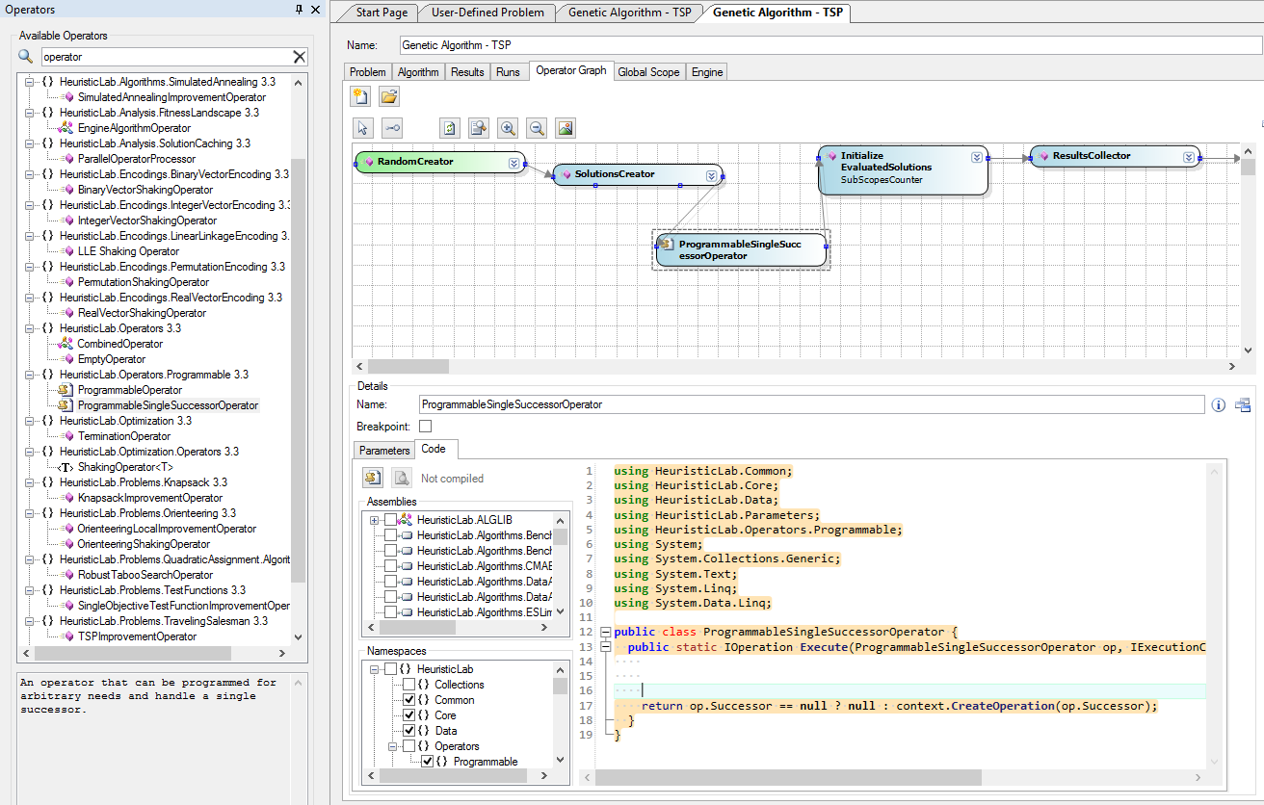
Programmable operators
Used in user-defined algorithms and problems
Used if there is
no appropriate operator available
creating a CombinedOperator is not desired
Programming skills required

Slide 8
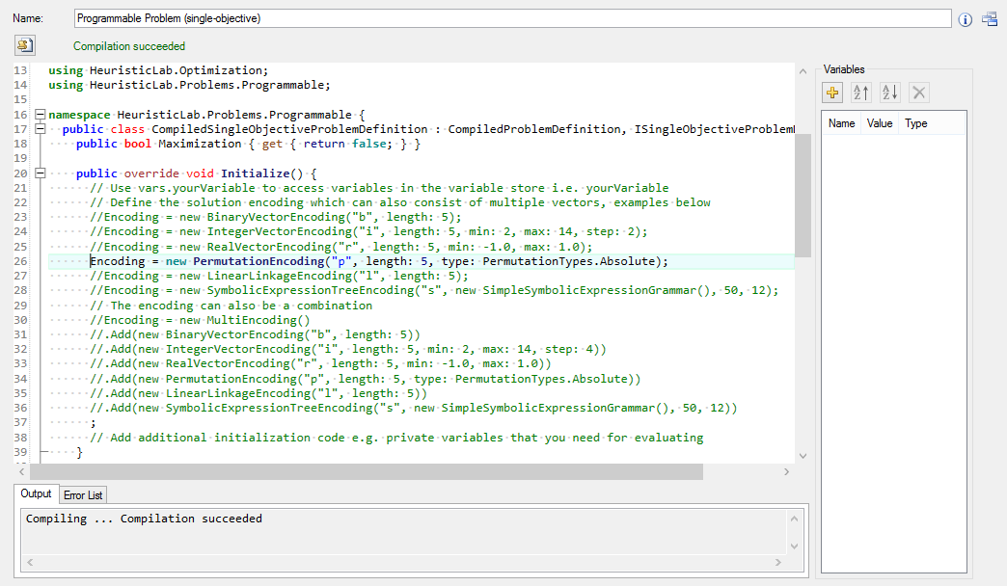
Programmable problem
Allows to define a problem in code in HeuristicLab
Similar to user-defined problem, but with C#
Only works if the encoding already exists
Multi-encodings are possible
Prototyping

Slide 9
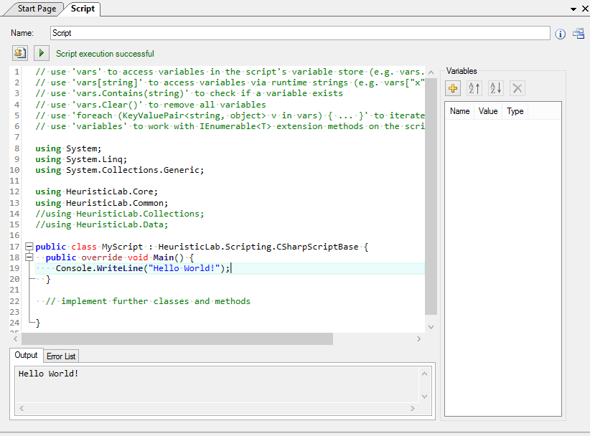
C# Script
Write programs from within HeuristicLab
Access to
HeuristicLab APIs
data types
views
Mainly used for
creating complex experiments
analysis
pre- and post processing
Prototyping

Slide 10
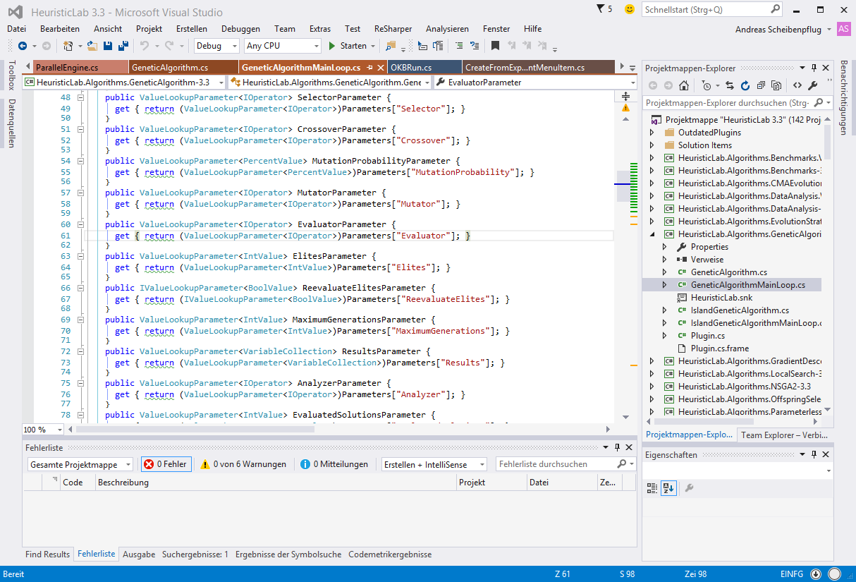
Plugins
Are loaded into HL on startup
Allow to add
algorithms
problems
operators
Some features can only be added by creating plugins
Data types
items
encodings
views
…
Most universal way of adding functionality to HL

Slide 11
Overview
Plugins
HL Object Model
Deep Cloning
Persistence
Items
HL Data Types
HL Collections
Content and Views
ViewHost

Slide 12
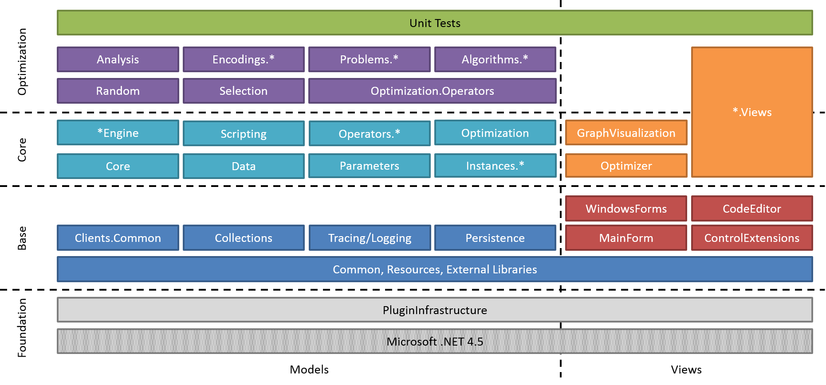
Where are we?

Slide 13
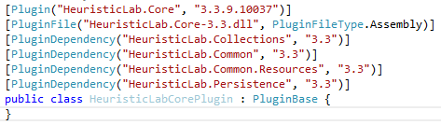
Plugins
Every plugin needs to contain a class that inherits PluginBase
If an assembly contains such a class, it is a plugin and loaded by HeuristicLab

Slide 14
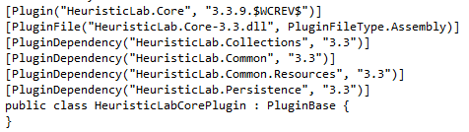
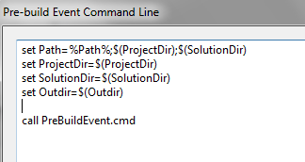
Plugins
PluginDependency must reflect references
Plugin Infrastructure does not have to be included as it is always needed
We normally use SubWCRev for version information

Slide 15
Some additional remarks
Plugins are signed with the HeuristicLab key
Every plugin builds to sources\bin (output path of project should be “..\..\bin\“ for all configurations adhering to standard HL folder structure)
Default namespace and assembly name should/must match plugin description
There should be x86, x64, Any CPU Debug and Release configurations
“Copy Local“ should be false for all Project/File references

Slide 16
HL Object Model

Slide 17
Deep Cloning
Objects in HeuristicLab that store data and may be displayed in views/collection views should be deep cloneable
UI allows “copying” of these objects
Inherit from either IDeepCloneable or Item
Implement interface and cloning constructor
Actual cloning happens in the cloning constructor

Slide 18
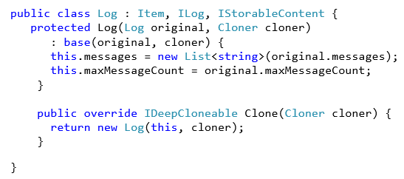
Deep Cloning
Item implements IDeepCloneable
Call cloning constructor which implements the cloning

Slide 19
Persistence
HL provides it‘s own serialization mechanism
A class that should be serializable has to be marked with the StorableClass[] attribute
Properties that should be serialized have to be marked with the Storable[] attribute
Storable constructor has to be implemented
Optional: Define hooks with attribute StorableHook[] to react on loading/saving events
Implement IStorableContent to signal that this is a root object

Slide 20
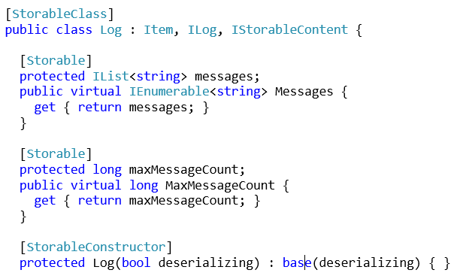
Persistence
Properties that should be stored in a file have to be marked with Storable[]
Mandatory storable constructor. Used by the persistence when deserializing.

Slide 21
Items
Items have
A name
A description
An icon
ToStringChanged and ItemImageChanged events
All Items are DeepCloneables and Storable
Most Items are marked as IContent to allow displaying in views
Use Item[] attribute to set name and description

Slide 22
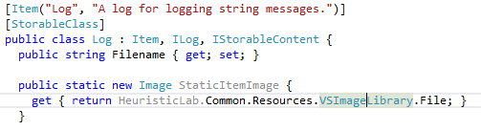
Items

Slide 23
HL Data Types
Located in HeuristicLab.Data (and corresponding views in Data.Views)
Wrap standard .NET data types and provide functionality necessary for UIs:
ValueChanged event
Parsing of strings
Validation
Data types include
IntValue, DoubleValue, PercentValue, StringValue,…
Ranges, Arrays, Matrices

Slide 24
Collections
Located in HeuristicLab.Collections/Core (and Core.Views for the corresponding views)
Same as with data types, provide UI friendly wrappers for .NET collections (e.g., additional events)
There are Lists, Arrays, Sets, Dictionaries and read-only collections
Most are designed for Items

Slide 25
Data Types and Collections
results.Add(new Result("MWIPS", new IntValue(intRating / 1000)));
DoubleValue doubleValue = new DoubleValue();
doubleValue.Value = resultValue.Value.Average();
[Storable]
private ItemList<ICovarianceFunction> terms;
public CovarianceSum()
: base() {
this.terms = new ItemList<ICovarianceFunction>();
}
terms.Select(t => t.GetNumberOfParameters(numberOfVariables)).Sum();

Slide 26
Content and Views
HL provides views for all data types, collections and much more (including input validation and updates)
Views display (and manipulate) Content
Use Content[] attribute to define the type of Content a View can display
Inherit UserControl from AsynchronousContentView or ItemView
Content is set by HeuristicLab or manually
React on events (e.g., OnContentChanged, (De)RegisterContentEvents, …)

Slide 27
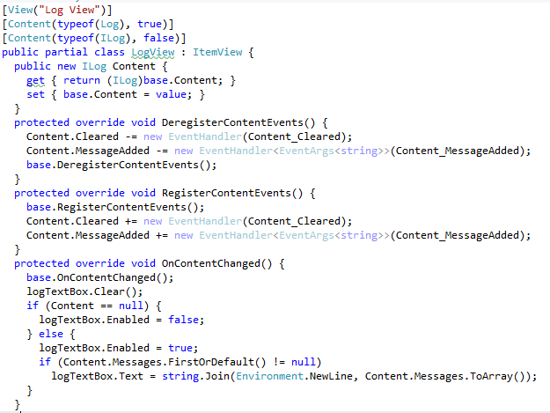
Content and Views
Defines what Content can be displayed with this view

Slide 28
Displaying Content
Manually:
Log log = new Log();
LogView logview = new LogView();
logview.Content = log;
In an own tab using discovery:
MainFormManager.MainForm.ShowContent(log);
Using a ViewHost
Log log = new Log();
LogView logview = new LogView();
logview.Content = log;
MainFormManager.MainForm.ShowContent(log);

Slide 29
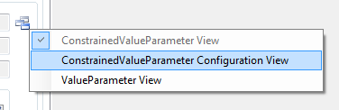
ViewHost
ViewHost is a special ContentView that changes it‘s appearance based on the type of Content
Content[] attribute marks a view for a certain content type
ViewHost looks up the view based on the Content type and uses it to display the Content
Useful for views that can contain different Content types or collection views

Slide 30
Useful Links
http://dev.heuristiclab.com/trac.fcgi/wiki/Documentation
http://dev.heuristiclab.com/trac.fcgi/wiki/Research
heuristiclab@googlegroups.com
http://www.youtube.com/heuristiclab

